Slide 1

Client side validation
By Uchit Shrestha and Nishan Shrestha

Slide 2
What is client side validation?
Client-side validation is an initial check and an important feature of good user experience; by catching invalid data on the client-side, the user can fix it straight away. If it gets to the server and is then rejected, a noticeable delay is caused by a round trip to the server and then back to the client-side to tell the user to fix their data.

Slide 3
Advantage of client side validation
Instant feedback : Client-side validation allows for immediate feedback to the user since it occurs in the user's browser without making a server request. This improves the user experience by reducing the waiting time.
Reduced server load: Validating input on the client side reduces the number of requests made to the server, offloading some of the processing work. This can improve server performance and reduce the load on the server.
Improved responsiveness: With client-side validation, users can quickly correct errors before submitting the form, leading to a smoother and more responsive user interface.

Slide 4
Disadvantage of client-side validation
Reliance on JavaScript: Client-side validation heavily relies on JavaScript being enabled in the user's browser. If JavaScript is disabled or not supported, the validation will not work, leading to incomplete or invalid form submissions. This can negatively impact the user experience and result in data inconsistencies.
Increased development complexity: Implementing client-side validation requires additional development effort and complexity. Developers need to write and maintain the validation logic in client-side scripting languages like JavaScript, which adds complexity to the codebase.
Security risks: client side validation can be easily bypassed by malicious users , who can manipulate the java script code or submit data directly to the server without going through the validation process .

Slide 5
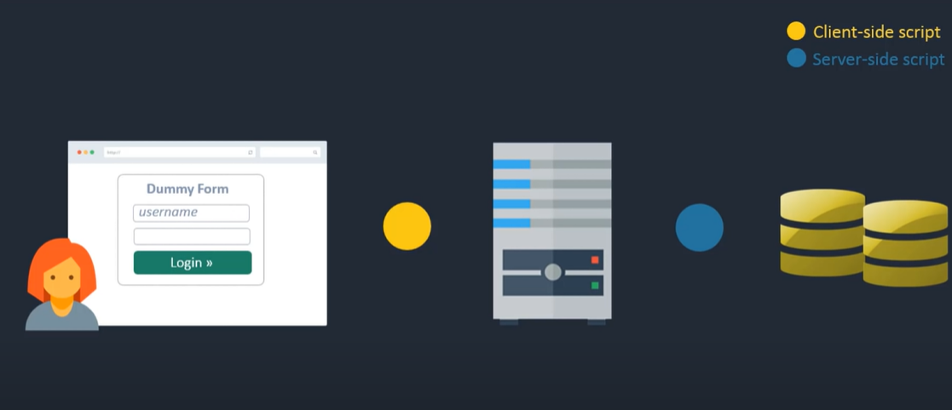
figure of client side and server side

Slide 6
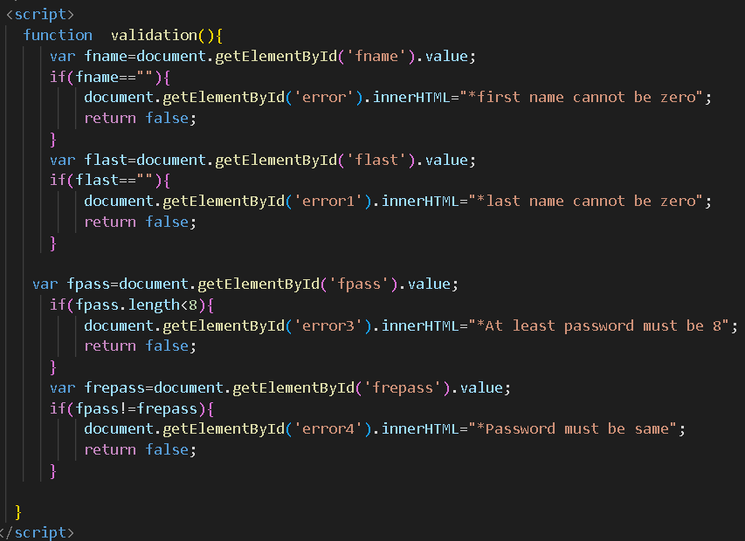

Slide 7
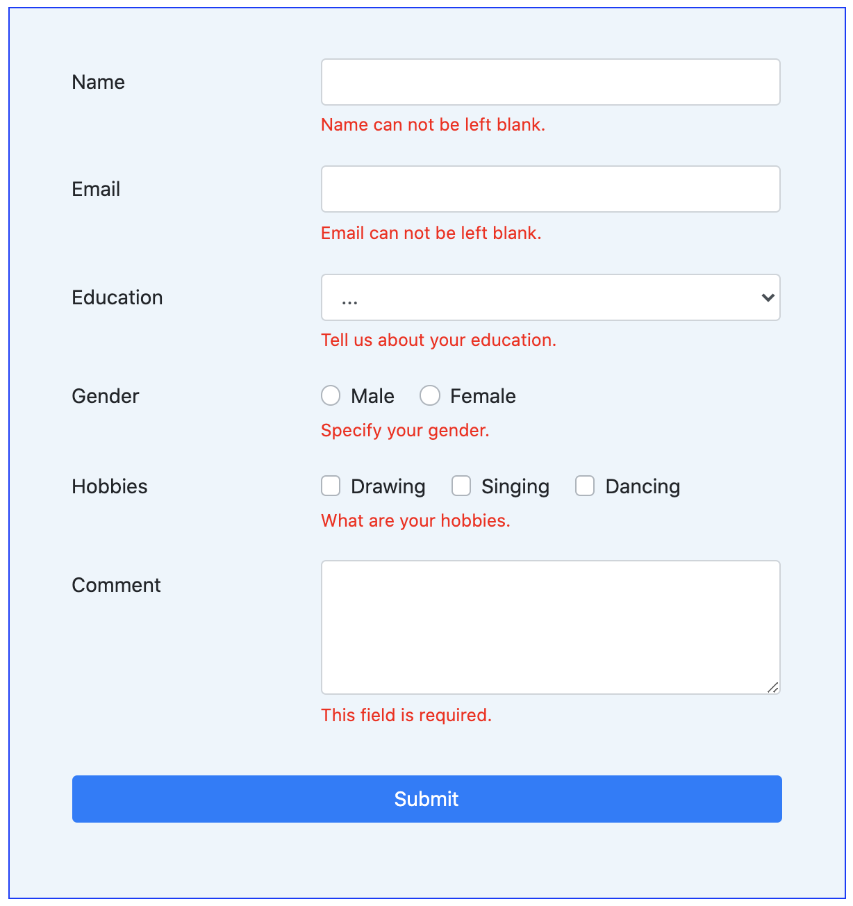
What is form validation?
Go to any popular site with a registration form, and you will notice that they provide feedback when you don't enter your data in the format they are expecting. You'll get messages such as:
"This field is required" (You can't leave this field blank).
"Please enter your phone number in the format xxx-xxxx" (A specific data format is required for it to be considered valid).
"Please enter a valid email address" (the data you entered is not in the right format).
"Your password needs to be between 8 and 30 characters long and contain one uppercase letter, one symbol, and a number." (A very specific data format is required for your data).

Slide 8
continue
This is called form validation. When you enter data, the browser or the web server will check to see that the data is in the correct format and within the constraints set by the application. Validation done in the browser is called client-side validation, while validation done in server is called server-side validation.

Slide 9
Different type of client side validation
JavaScript Validation
Built-in Form Validation

Slide 10
JavaScript validation
JavaScript validation is coded using JavaScript and is more customizable than built-in form validation. It gives you more control over the design, feel, and microcopy of your validation messages, allowing you to create forms that express your brand’s identity.
However, as you can probably guess, validating forms using JavaScript requires pretty extensive coding knowledge and stricter continuous testing processes in response to code changes.

Slide 11
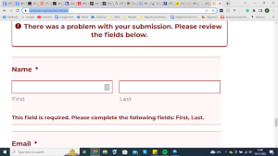
Built-in Form Validation
Built-in form validation uses HTML5 to perform data validation instead of the more traditionally-used JavaScript. It’s well-supported by popular modern browsers (Safari, Firefox, etc.)
Its ability to independently validate user data is made possible through the use of validation attributes of the form elements. For example:
“Type”: Defines the specific type of data that should be inputted (email address, URL, phone number, etc,).
“Required”: Marks the form field as mandatory, meaning it must be filled in before submission.
“Pattern”: Dictates regular expression (pattern) rules that the inputted data needs to abide by for validation.

Slide 12
Thank you

